Slide 1
XP is Extreme Programming
Lean Software Development
Mark Windholtz
ObjectWind Software Ltd

Slide 2
Who Am I
Mark Windholtz
ObjectWind Software Ltd
14 years Building Professional Software
Business, Medical, Engineering, Military
First contact with XP in Oct 1996
Started Six XP teams
Consulted for Eight other XP teams

Slide 3
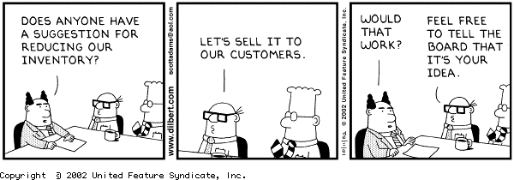
Dilbert

Slide 4
Agenda
Lean Goals
Development in Phases
Lean Concepts
Fit & Fitnesse

Slide 5
Lean Thinking Companies
Fed Ex
LensCrafters
SouthWest
Toyota

Slide 6
Lean Goals
Remove Waste
  To increase the ration of Value / Cost
Increase Responsiveness
  To better define Value
Amplify Learning
  So as to continuously improve…
    Identification of waste
    & Feedback cycles

Slide 7
Example 1
3 applications into production
Web portals
very complex employee transition management
Delivers every 2 weeks to production
SIP ~10
  One Defect in last 9 months
Notes:
Low defect rate enable low SIP
Provides feedback to keep defects low

Slide 8
Inventory is Waste
Inventory is a non-producing Asset
Inventory reduces responsiveness
Any Artifact not producing Current Income
Unimplemented Features are Inventory
    Don’t know if/how it will work
      until it does work (Risk)
    High Administrative costs
    Reduced response to changing markets
    Higher (Longer) Return on Investment
      Consider: Net Present Value
    Time between Idea and Market feedback

Slide 9
Development in Phases
Specification
Phase
Design
Phase
Coding
Phase
Test
Phase
Production

Slide 10
Lean Concepts
Value
  What the Customer will pay for
Pull
  Respond when the Customer asks
Flow
  Move value smoothly, continuously
Perfection
  Quality is Free (Questcon presentation)
  Continuous Improvement

Slide 11

Value
they know the Cost of everything
but the Value of nothing - Oscar Wilde

Slide 12
Customer Value
Business Value
  What makes money for Business
  Not always newest Technology
  Sometimes a Simple Solution
Understanding Customer
  Communicating Continuously
  Feedback Loops
  Important Project get On-site Customer
  Un-important Project: Save your Money

Slide 13
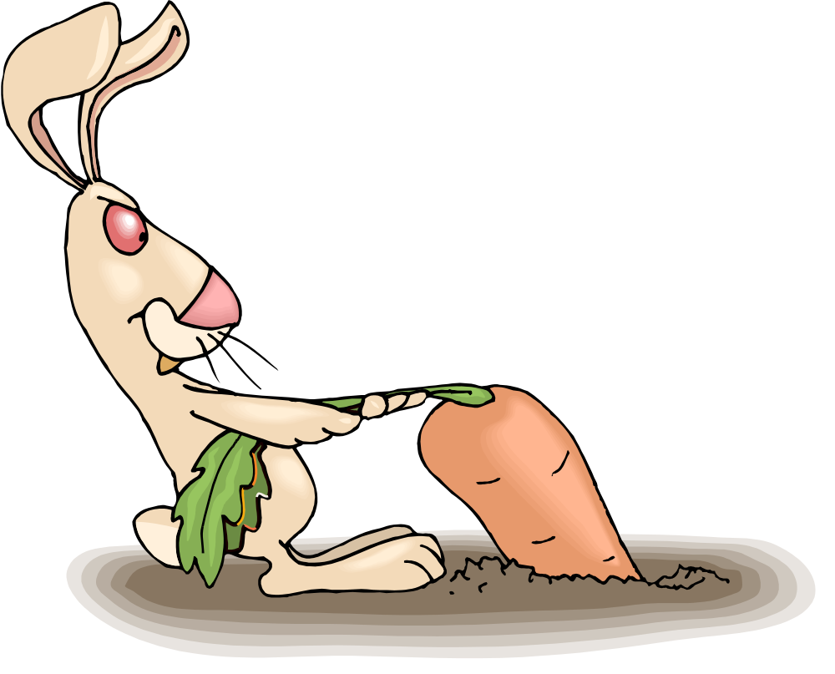
Pull

Slide 14
Push
A lot of stuff is produced,
  Then force someone to buy it.
New Car feature packages
Sales items
Coupons
Volume discounts
Why did I buy that?
Big Batches of requirements

Slide 15
What’s your top Problem?
That’s Easy!
Typical s/w project 6-12 months
Quiz:
  In one year what will be your top 40 business problems?
Ummm ??

Slide 16
Just In Time Software
Let Customer choose Value
Reduces waste of Over-Engineering
Deep Focus on quickest payback
Most
Important
feature
Most
Important
feature
Most
Important
feature
Most
Important
feature
Specify
Specify
Specify
Specify
Design
Design
Design
Design
Code
Code
Code
Code
Test
Test
Test
Test
Deploy
Deploy
Deploy
Deploy

Slide 17

Flow

Slide 18
Flow: Small batches
More Predictable, Lower Stress
Eliminate Rework
  Reconnect: defect - code - spec - test
Continuously …
  Communicate
  Improve Design
  Test
  Integrate
What is the effect on flow
when test-at-end finds a defect?
Test early, improve flow
Specify
Design
Test-First
Code
Design
Test
Deploy

Slide 19
Example 2
www.lifeware.ch
4000 tests run with every change
Changes go into production every evening
Only needed workflows implemented
Policy redemption not coded until requested
Low cost of operation
SIP = 1

Slide 20

Perfection: Fitness Testing

Slide 21
Acceptance Testing
Test Features at the end of production
Pro
  Bad defects don’t ship ($: fix or delay)
Cons
  Minor defects too late to fix, so they ship
  Too late to help during programming
  Expensive and often Manual
  Takes a long time

Slide 22
xUnit Testing
jUnit (xUnit for Java) is industry standard
Pros
  Test-first design is very powerful
  Allows for changing requirements
  Produces better modular design
  Reduces technical defects
Cons
  Most defects are in communication about specs
  xUnit helps the trees but not the forest

Slide 23
Fit & Fitness
Fit
  Write tests for features before programming
  Test written as html tables
  Domain Expert can specify fitness criteria
Fitnesse
  Tool to input and organize fit tests
  Wiki based for Collaborative web building

Slide 24
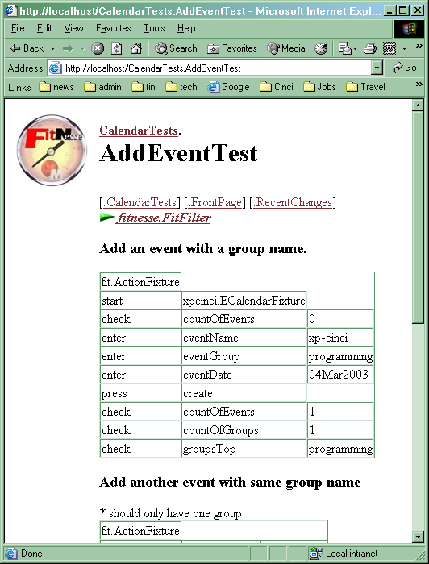
Basic

Slide 25
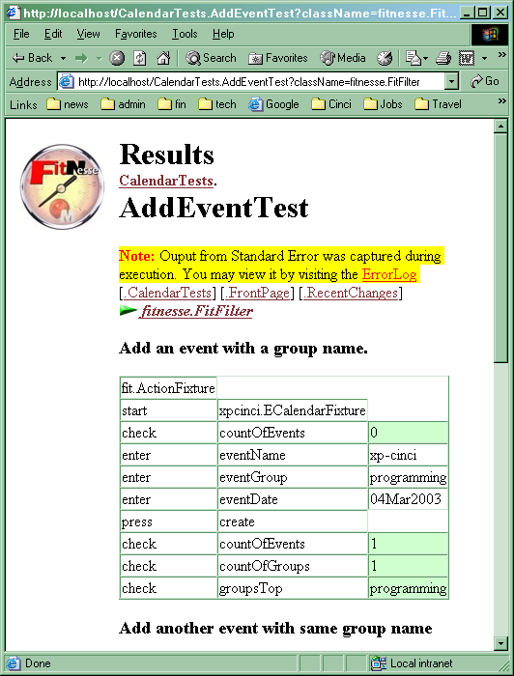
Green

Slide 26
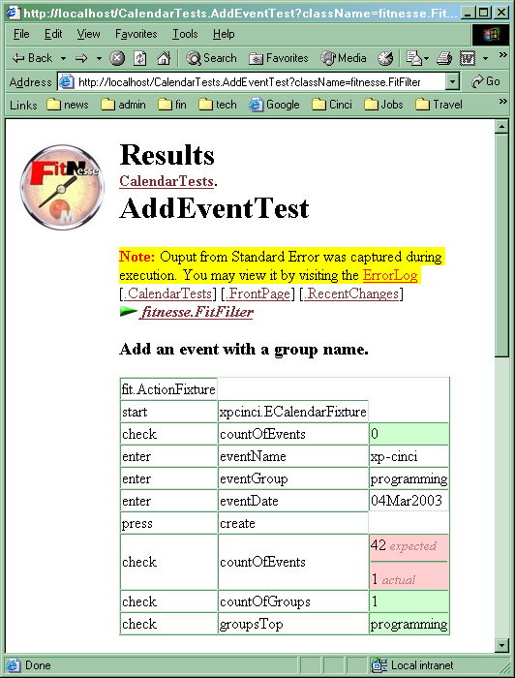
Fail

Slide 27
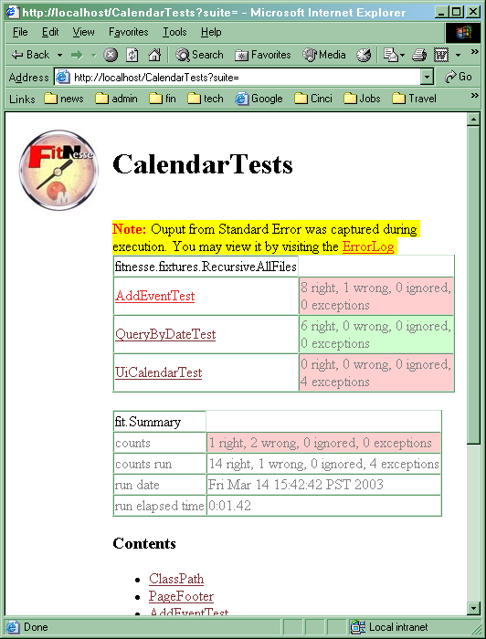
suite

Slide 28
Fit: How it works
Fixture to “hold” real code
Tests As
Html Tables
Production code

Slide 29
How to be Lean
Reduce Waste - Inventory
  Artifacts: Smaller , fewer, more useful docs
  Code size: Refactor (Once and Only Once)
Increase Responsiveness
  Communication: sit together
  Testing: test-first
  Focus: single piece flow

Slide 30
Business Models
Lean Software Development
  Enables
    Shorter Investment Cycles
    Increased ROI
    Subscription based software
    Responding to Market
  Requires
    Change in thinking
    Greater Feedback
    Courage !

